Slide 2
Exploratory Data Analysis
2053 rows and 81 columns
34 numeric columns: mostly SF and count of rooms etc.
47 categorical columns
No missing values in the dataset
Columns include Sq Ft. of all floors and basements, bathroom counts, bedroom counts, quality of each section in the house etc.
SF can be merged together (Basement, First Floor, Second Floor)
Bathrooms can me merged together (Basement Full/Half, Full/Half)

Slide 3
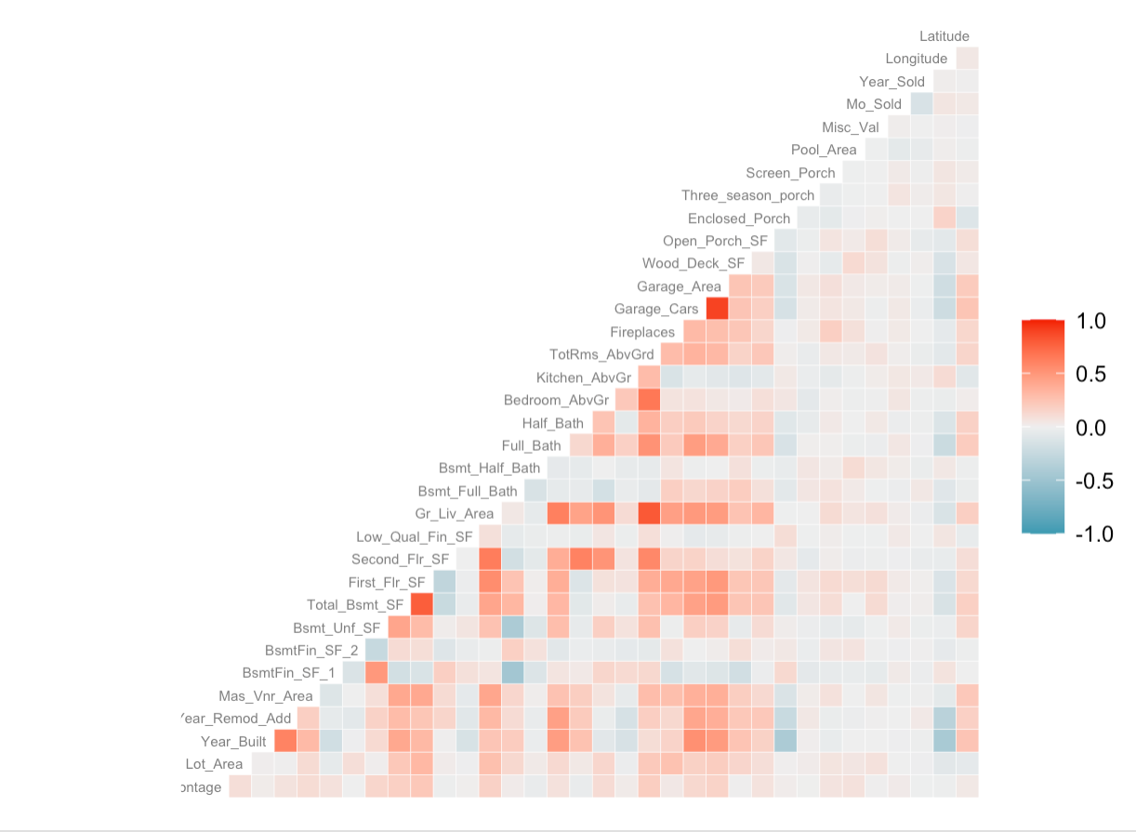
Correlation
Year_Built, Year_Remod_Add = 0.6
First_Flr_SF, Total_Bsmt_SF = 0.78
Second_Flr_SF, Gr_Liv_Area = 0.63
Garage_cars, Garage_Area
Year_built, enclosed_porch
Totrms_abvgrd, fr_liv_area
These are all logical correlations between two variables.

Slide 4
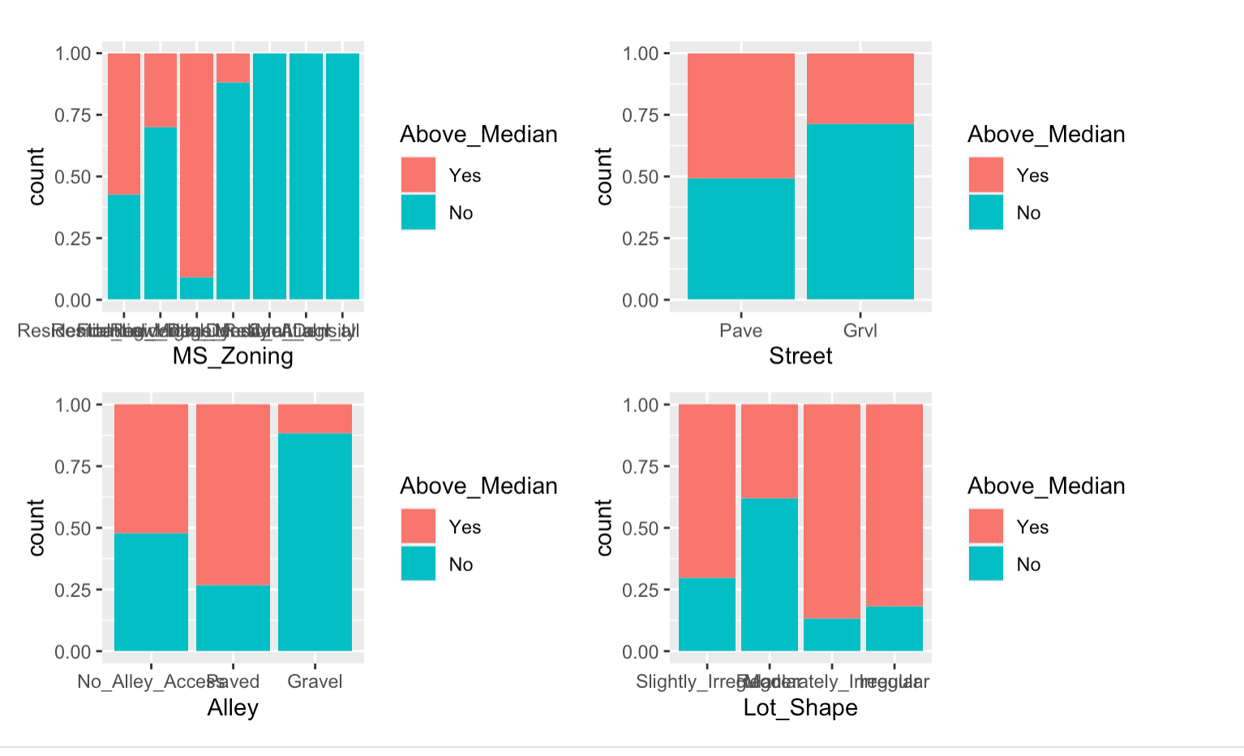
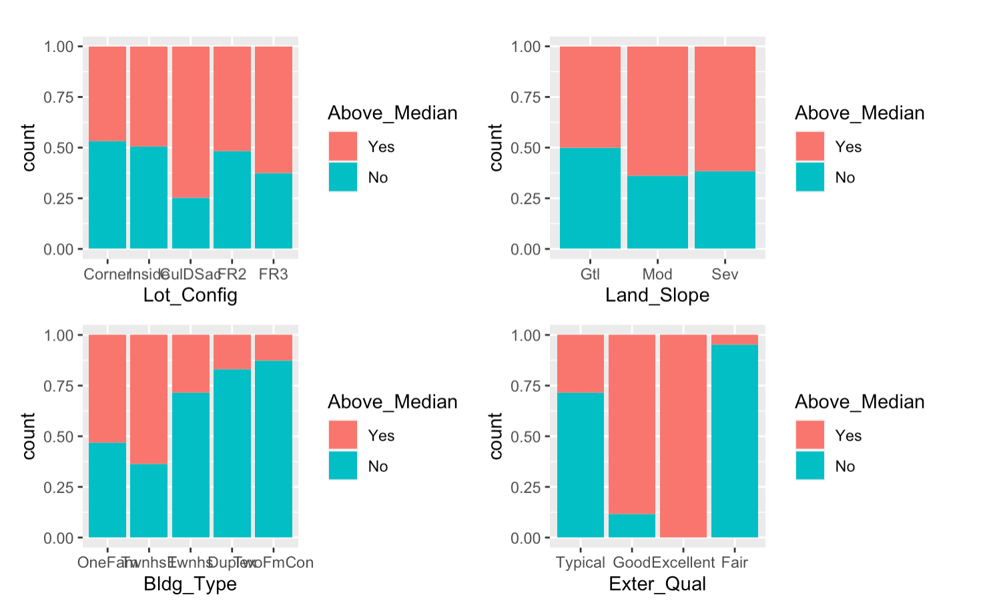
Visualizations
Land_Slope variable doesn’t seem to affect Above_Median too much
3 out of 7 categories in MS_Zoning doesn’t affect Above_Median at all

Slide 5
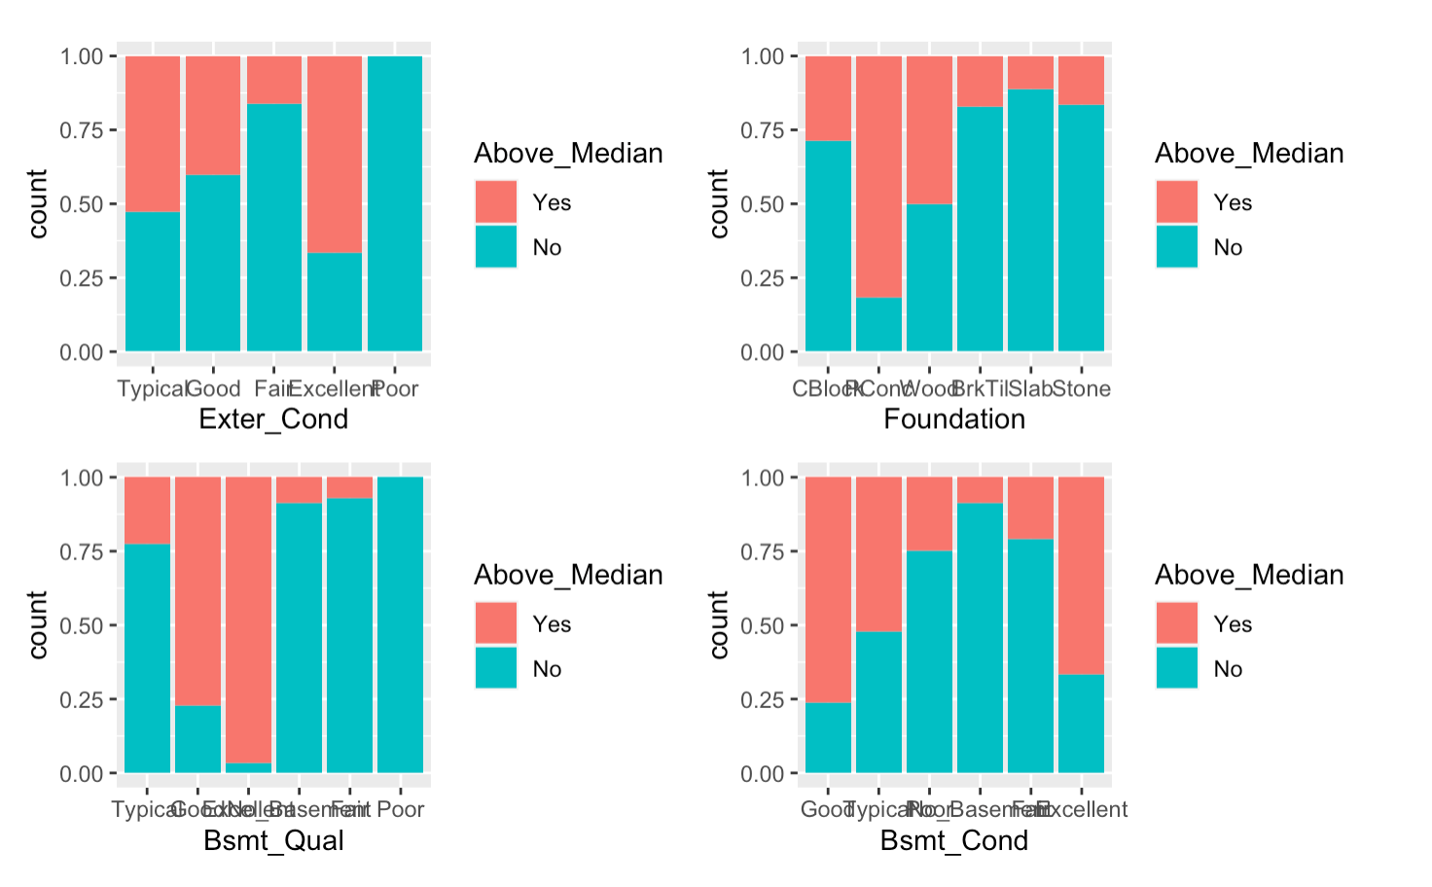
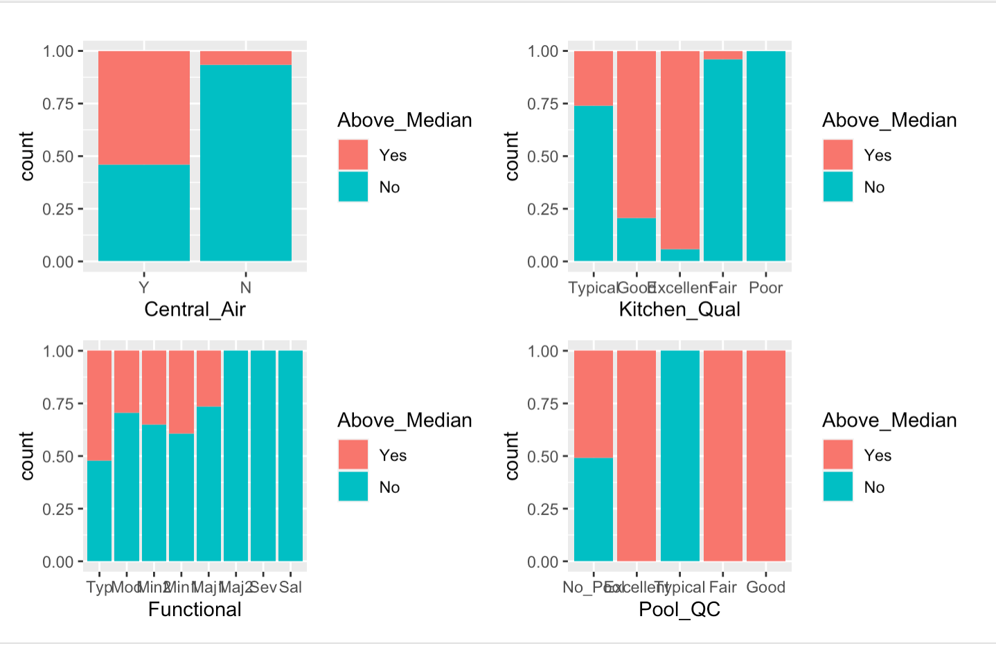
Visualizations
All the variables above seem to be very good predictors.

Slide 6
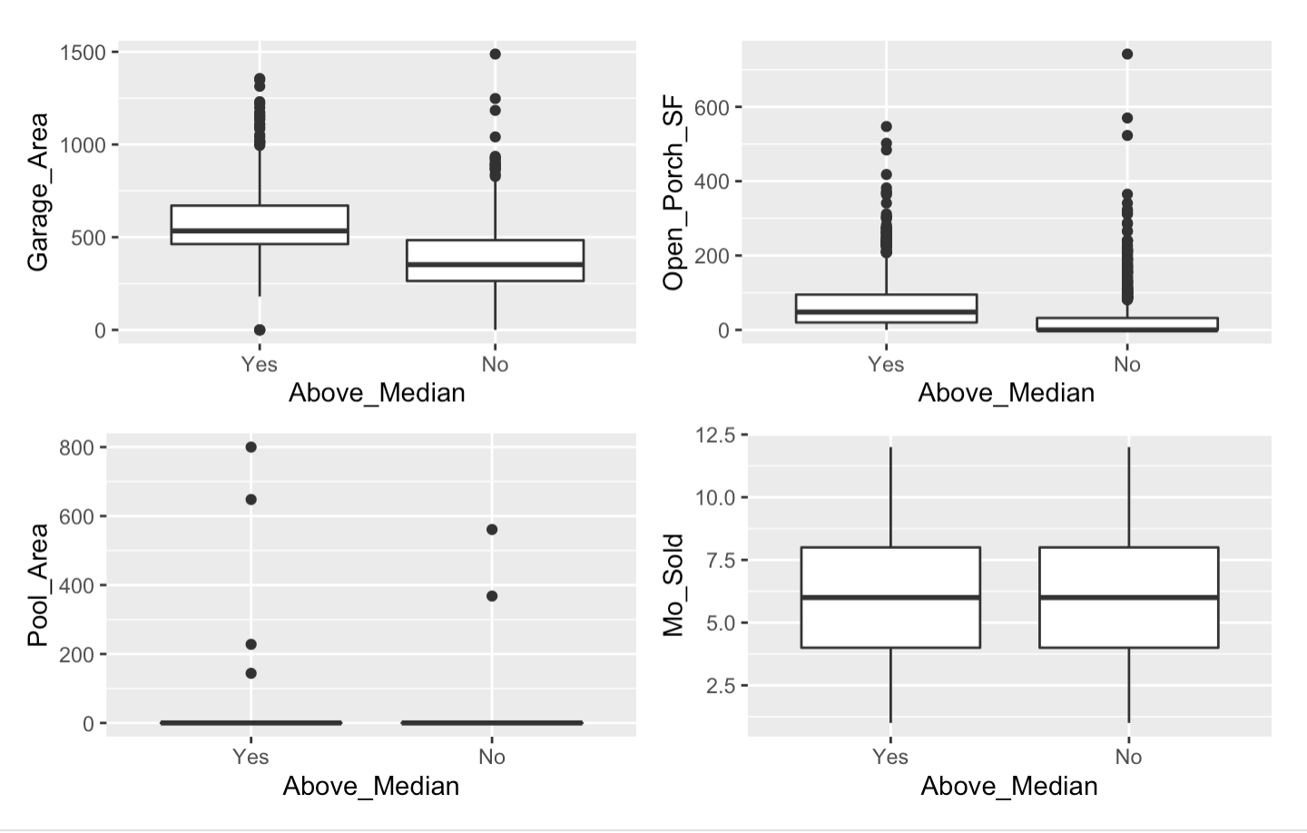
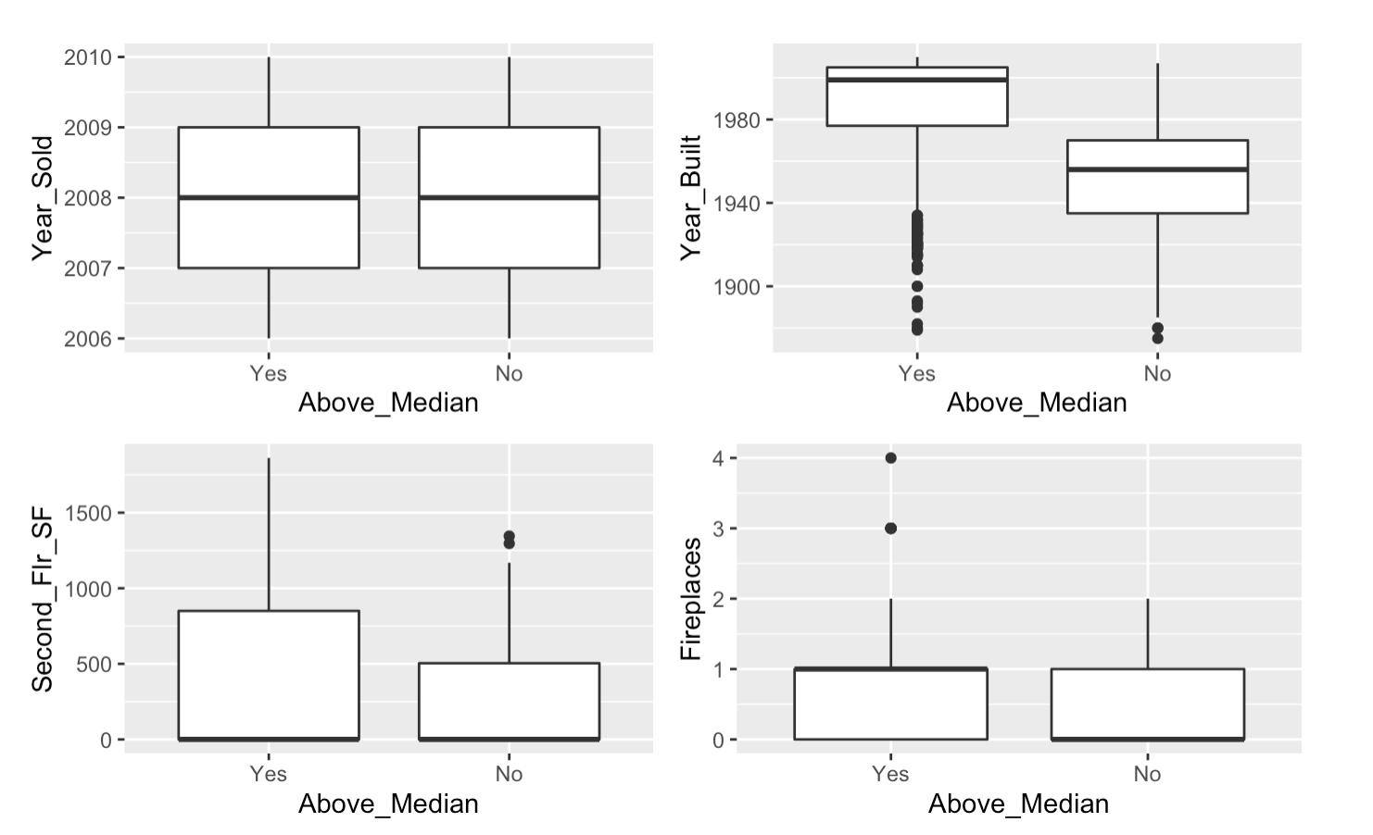
Visualizations
Year_Sold, Second_Flr_SF, Pool_Area are NOT good predictors
Year_Built, Garage_Area, Fireplaces are very good predictors

Slide 7
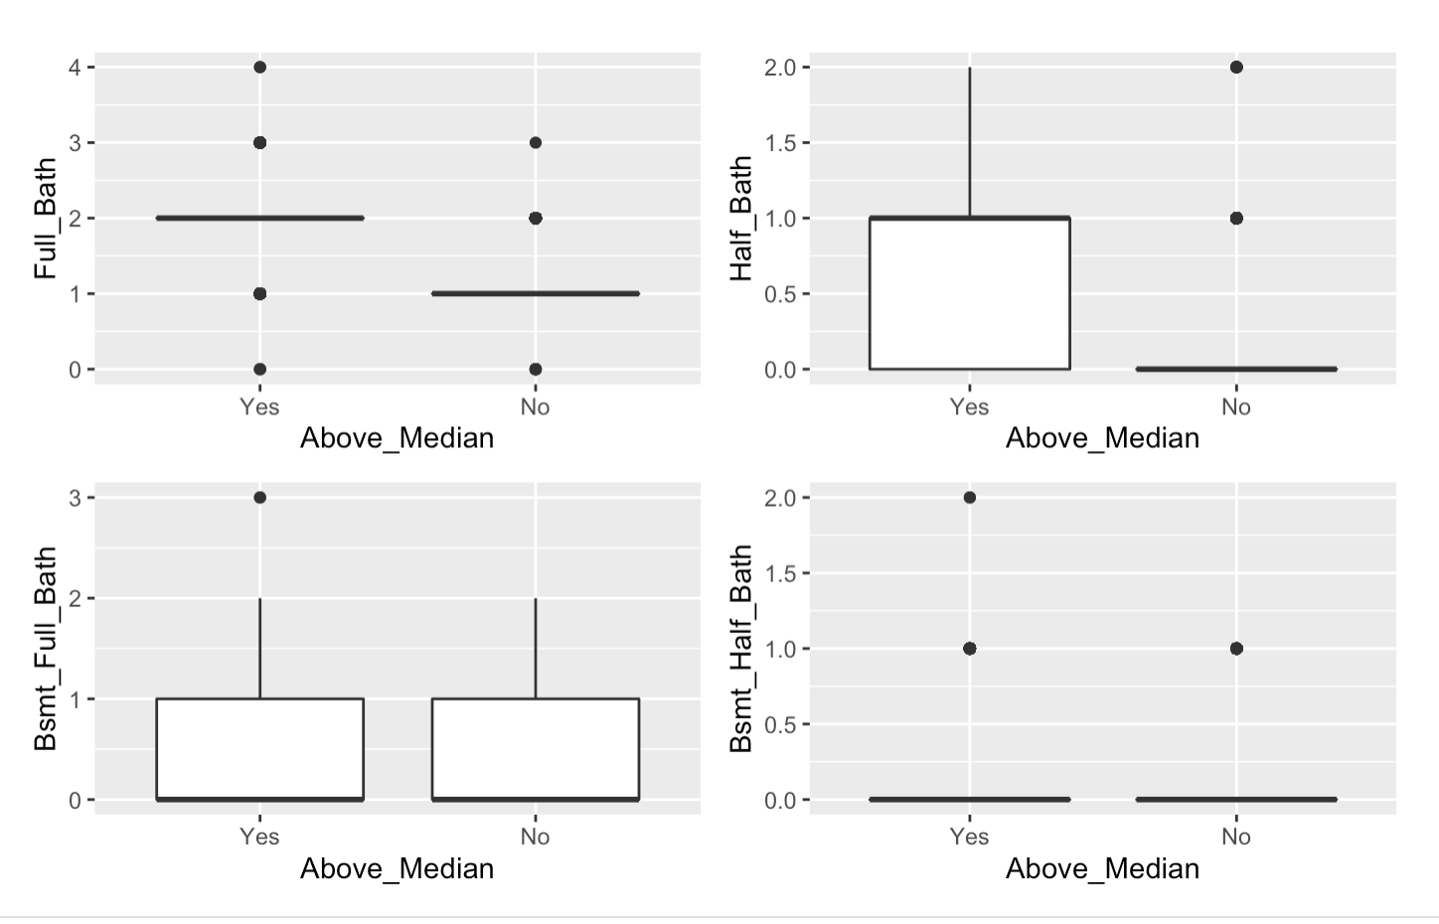
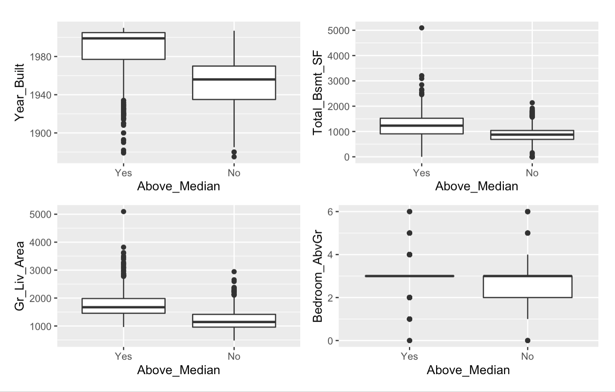
Visualizations
Bsmt_Full_Bath, Bsmt_Half_Bath, Bedroom_AbvGr are NOT good predictors
Full_Bath, Half_Bath, Gr_Liv_Area, Total_Bsmt_SF are very good predictors

